Slide 1
GRAPH THEORY APPS IN COMPUTATIONAL POETRY ANALYSIS
The Graph Poem Team (School of Electrical Engineering and Computer Science & Faculty of Arts):
Chris Tanasescu (MARGENTO)
Diana Inkpen
Vaibhav Kesarwani
Bryan Paget

Slide 2
Graph Theory Essentials
A graph is a collection of vertices (points) that are connected by edges (lines).
Formally: A graph is an ordered pair G = (V, E) comprising a set V of vertices or nodes or points together with a set E of edges or arcs or lines, which are 2-element subsets of V (i.e. an edge is associated with two vertices, and that association takes the form of the unordered pair comprising those two vertices). To avoid ambiguity, this type of graph may be described precisely as undirected and simple.
Examples: WWW, Social Media, molecules in chemistry, etc.

Slide 3
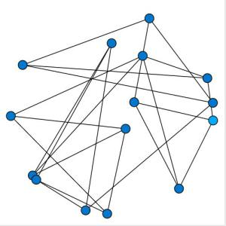
Graph Theory Essentials

Slide 4
Why Apply Graph Theory in Poetry?
Find a formalized way to represent and analyze poems within and across poetry corpora
Process automatically large poetry datasets in the age of big data/data-intensive research, distant reading, “the big unread,” etc.
By studying specific features of a poetry graph we will find out extremely useful and sometimes surprising things about various poetry corpora potentially relevant to researchers in lit criticism & theory, poetics, lit history, DH, computational linguistics, cultural studies, cultural analytics, etc.
Developing apps useful in creative writing
Also (or mainly), because I had this crazy idea back in 2010
Well, SSHRC gave us funding to do it…

Slide 5
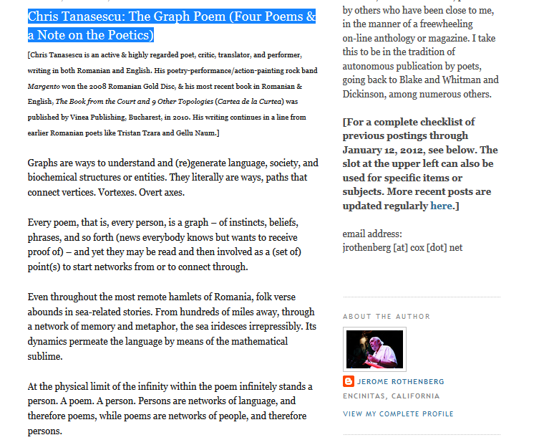
“The Graph Poem (Four Poems and a Note on the Poetics)” http://poemsandpoetics.blogspot.ca/2011/03/chris-tanasescu-graph-poem-four-poems.html

Slide 6
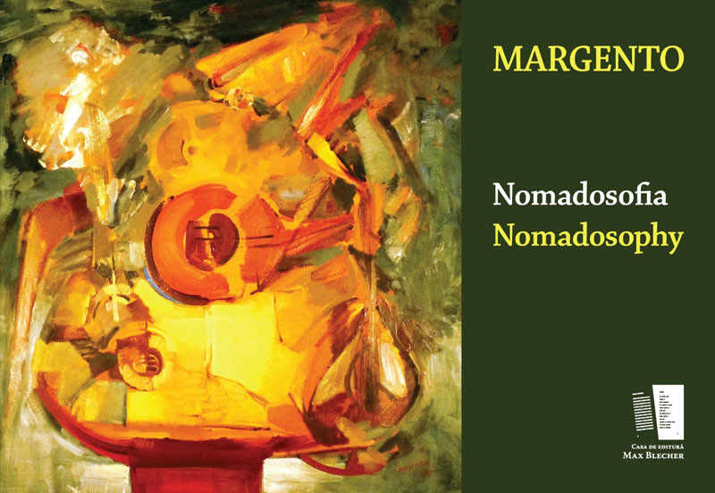
A manually assembled graph poem
MARGENTO. (2012). Nomadosofia (poem graf) /Nomadosophy (a graph poem). Max Blecher Press.

Slide 7
MARGENTO--Nomadosophy
"Margento is a caravan, a circus, a symphony, and a brawl. It is a global, multi-languaged, powerful performance troupe made of more than fifty poets (from Darwish to Ly Doi, Levine to Ng to Oeur) working in a brand-new kind of theater. And its conductor, impresario, and visionary puppet-master is the brilliant Romanian poet and performer Chris Tanasescu. In his hands, in his head, and with his orchestration, poetry comes vitally alive in a shared, communal, polyphonic, and charged new way - rich with political aptitude and buzzing with lyrical pizzazz - as it seeks to remember our many origins, roaming on toboggans, fishing boats, and taxicabs alike, and searching for a place for the night. Songs alongside footnotes, tiny imagist poems loaded like bombs inside rangy prose documents, lyrics within dramatics within call-and-response meta-texts, the four primary "poems" of Nomadosofia cover the globe with poetry that leaps over borders, from erotic to elegiac, holy to profane, formal to wildly improvised, ancient yet as new as the latest zip-drive. If you want to hear a poetry as representative, as capacious, and as timely as is humanly possible, turn on Nomadosofia and, I predict, soon you'll be singing along. Everyone's welcome." David Baker

Slide 8
Computational Tools and Apps
Topic classifier: “Multilabel Subject-Based Classification of Poetry.” Andrés Lou, Diana Inkpen, and Chris Tanasescu (Margento) (2015) http://www.aaai.org/ocs/index.php/FLAIRS/FLAIRS15/paper/viewFile/10372/10322
Meter and rhyme: “Automatic Classification of Poetry by Meter and Rhyme.” Chris Tanasescu (Margento), Bryan Paget, and Diana Inkpen (2016) www.aaai.org/ocs/index.php/FLAIRS/FLAIRS16/paper/download/12923/12883
Metaphor detection and processing: Vaibhav Kesarwani
Rhyme classifier and visualization app: Vaibhav Kesarwani
“Access(ed) Poetry. The Graph Poem Project and the Place of Poetry in Digital Humanities” @ DH2017

Slide 9
Automatic Poetry Classification by Metaphor (GraphPoem Project)
Vaibhav Kesarwani
Dr Chris Tanasescu (MARGENTO)
Dr Diana Inkpen
Collaborator: Dr Stan Szpakowicz

Slide 10
Types of Metaphors
Type 1 : Noun-verb-noun, where verb is copula verb like [is, are, was, were, be, am].
Eg : Eyes are lakes
Type 2 : Noun-verb-noun, where verb is any non-copular verb like [eats, runs, played, etc..]. Eg : Car drinks gasoline.
Type 3 : Adjective-noun sequence.
Eg : Dark thoughts.
Type 4 : Noun-verb sequence.
Type 5 : Verb-verb sequence.

Slide 11
Rule Based Method (Neuman et al.)
Concrete-Abstract rule : Noun1 is concrete & noun2 is abstract
Eg : Eyes are strangers
Concrete-Class Overlap rule : If both noun are of concrete class, check for hypernym overlap
Eg : My lawyer is a shark
WordNet is used to find the noun classes and the hypernyms

Slide 12
Word Embeddings Based Method (Working Hypotheses)
Word2Vec model (trained on Gigaword corpus) used to get word vectors of noun1 & noun2
Features Used:
Cosine Similarity of both vectors
Vector Difference of both vectors (with 100 dimensions) to capture contextual contrast
PMI (Pointwise Mutual Information) of both words (trained on British National Corpus)
ConceptNet Overlap computed from SurfaceText entities of ConceptNet knowledge base

Slide 13
Results (Preliminary)
Rule-based methods (baseline): 69.10%
WordEmbeddings on Poetry Foundation poems: 74.40%
WordEmbeddings on Shutova data: 75.58%
WordEmbeddings on TROFI data: 79.00%

Slide 14
Challenges
Distinguish between common-speech and “poetic” metaphors
Identify metaphor networks within poems and across corpora based on:
(related) words shared,
syntactic structure (models 1-5 above),
vector difference between tenor and vehicle (basis for quantification)

Slide 15
“Impossible” Goals for Future Work
“But, soft! What light through yonder window breaks?/ It is the east, and Juliet is the sun.”
( Romeo and Juliet, Act 2, Scene 2)
“[A]lthough these metaphors, including “Juliet is the sun” can be interpreted in the local context of the lines in which they appear, they are much more meaningful when interpreted in the broader context of Act 2, the entire play, and cultural conventions associated with the metaphor field, X IS LIGHT.” (L. David Ritchie 2013)

Slide 16
Thanks

Slide 17
Automatic Poetry Classification by Rhyme (GraphPoem Project)
Vaibhav Kesarwani
Dr. Margento
Dr. Diana Inkpen

Slide 18
Types of Rhymes Identified
Positional:
End rhyme
Internal rhyme
Phonemic:
Full rhyme
Slant rhyme
Identical rhyme
Eye rhyme
Rich rhyme

Slide 19
Method
CMUDict (CMU Pronouncing Dictionary) is an open-source machine-readable pronunciation dictionary for North American English that contains over 134,000 words and their pronunciations.
Pronunciation is fetched for all words in a poem:
PROCESS P R AA1 S EH2 S
PROCESS(1) P R AO1 S EH2 S

Slide 20
Poem Phoneme Matching
Title : Summer begins to have the look
Author : Emily Dickinson
"Summer begins to have the look",
"Peruser of enchanting Book",
"Reluctantly but sure perceives",
"A gain upon the backward leaves ",
"Autumn begins to be inferred",
"By millinery of the cloud",
"Or deeper color in the shawl",
"That wraps the everlasting hill.",
"The eye begins its avarice",
"A meditation chastens speech",
"Some Dyer of a distant tree",
"Resumes his gaudy industry.",
"Conclusion is the course of All",
"At most to be perennial",
"And then elude stability",
"Recalls to immortality."
S_AH1_M_ER0 B_IH0_G_IH1_N_Z T_UW1#T_IH0#T_AH0 HH_AE1_V DH_AH0#DH_AH1#DH_IY0 L_UH1_K
AH1_V#AH0_V EH0_N_CH_AE1_N_T_IH0_NG#EH0_N_CH_AE1_N_IH0_NG B_UH1_K
R_IH0_L_AH1_K_T_AH0_N_T_L_IY0 B_AH1_T SH_UH1_R P_ER0_S_IY1_V_Z
AH0#EY1 G_EY1_N AH0_P_AA1_N DH_AH0#DH_AH1#DH_IY0 B_AE1_K_W_ER0_D L_IY1_V_Z
AO1_T_AH0_M B_IH0_G_IH1_N_Z T_UW1#T_IH0#T_AH0 B_IY1#B_IY0 IH2_N_F_ER1_D
B_AY1 AH1_V#AH0_V DH_AH0#DH_AH1#DH_IY0 K_L_AW1_D
AO1_R#ER0 D_IY1_P_ER0 K_AH1_L_ER0#K_AO1_L_ER0 IH0_N#IH1_N DH_AH0#DH_AH1#DH_IY0 SH_AO1_L
DH_AE1_T#DH_AH0_T R_AE1_P_S DH_AH0#DH_AH1#DH_IY0 EH2_V_ER0_L_AE1_S_T_IH0_NG HH_IH1_L

Slide 21

Rhyme Score
Consecutive Rhyme: When rhyme is present in consecutive lines.
Alternate Rhyme: When rhyme is present in alternate lines.
Distant Rhymes: Separated by more than one line; recurrent rhymes across a poem, a collection, oeuvre(s), corpora.
For each word :
Total RhymeScore for a poem:
RhymeScore_{total} = ∑ {RhymeScore_{word}}
Normalization needs to be done for this score, so that a longer poem does not have advantage over a shorter one.
RhymeScore_{norm} = RhymeScore_{total} / norm_{f}

Slide 22
Automated Classification
Classes used for classification: full, slant, identical, rich, eye, internal
Dataset contains 12,831 poems from Poetry Foundation
“Plotly” visualization framework used for graph visualization
Visualization done on 2D/3D scatter plots for each poem based on the RhymeScore metric

Slide 23
“Impossible” Goals for Future Work
Process all sonic techniques—alliteration, consonance, assonance, echoic features, etc.
Quantify euphony
Automated distinction between euphony and cacophony
Consolidating numerical and non-numerical sound-based commonalities

Slide 24
Web Application Demo...

Slide 25
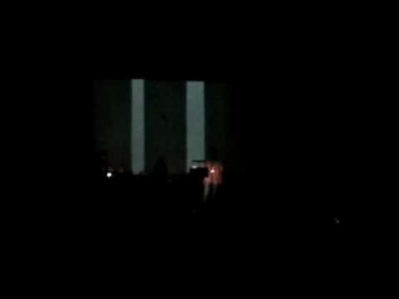
The Graph Poem as Cross-artform Performance
The 1st European Poetry Slam Festival, Berlin 2009; festival opening performance

Slide 26
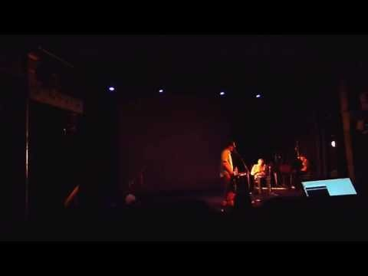
The Graph as Inter(-Re)Mediated (Post)Digital (Re)Performance Poetry
The Electronic Poetry Conference, Kingston U, London, 2013
Re-performance and re-enactment involving re/dis-placement & remediation that translates the graph poem as a processual corpus into postdigital negotiations, alternations, and con-fusion(s) between real and documented, between the artificially (and therefore mediated) “unmediated” and successive layers/stages of gradated and hybridized inter(-and-re)-mediation.

Slide 27
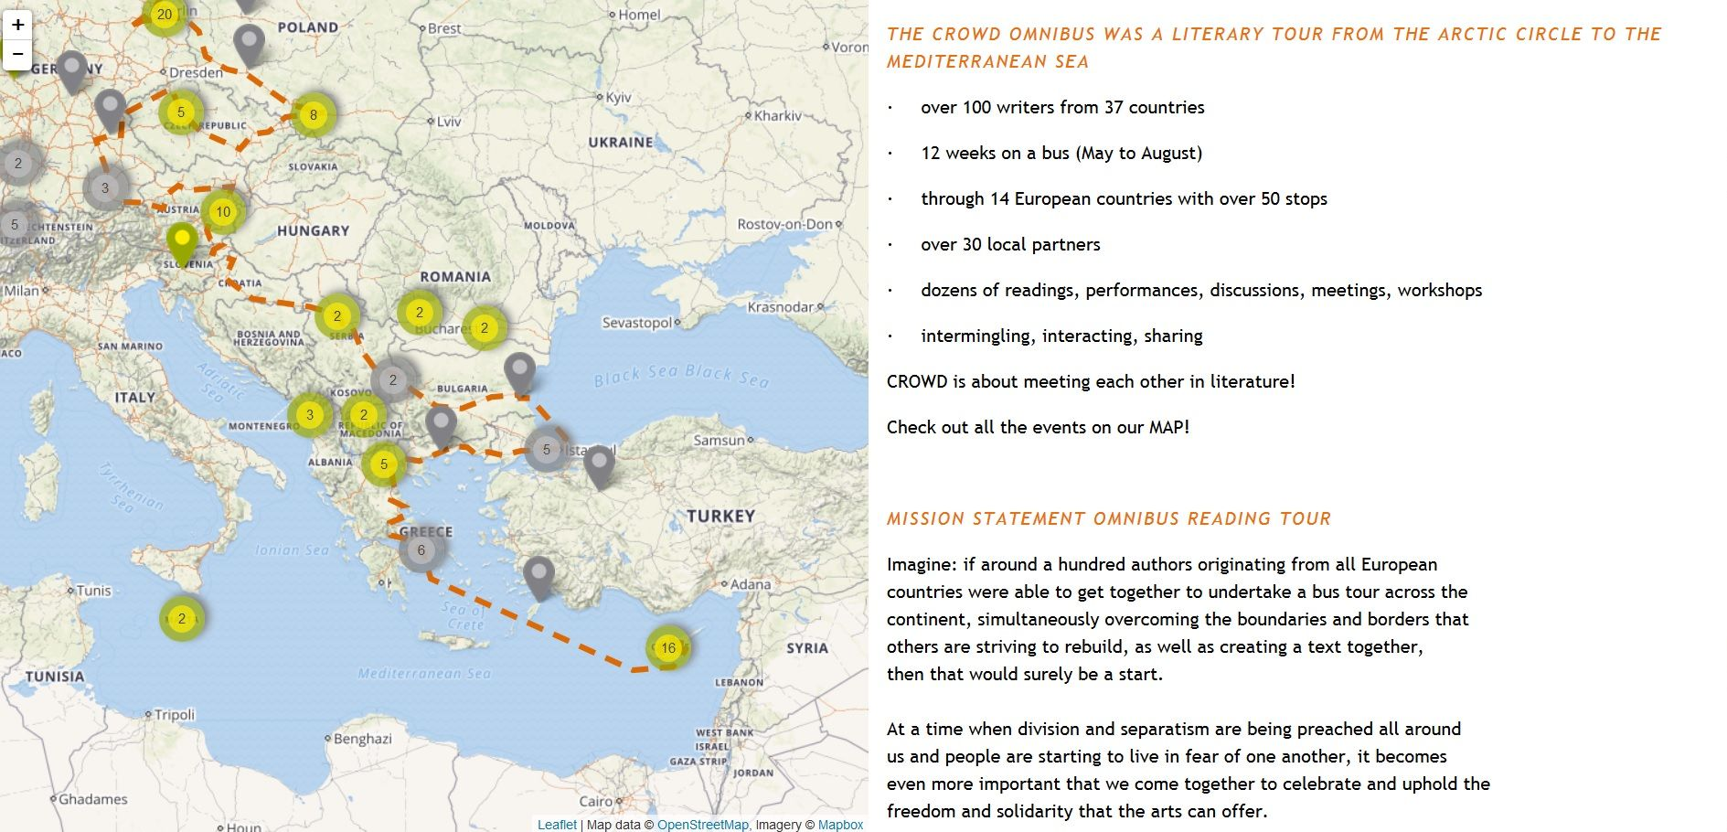
CROWD (CReating Other Ways of Dissemination) Omnibus Literary Tour (2016) http://crowdlitbus.eu/#/start

Slide 28

CROWD http://crowd-literature.eu/one-is-a-crowd-margento/

Slide 29
To be continued…
http://artsites.uottawa.ca/margento/en/
Thank you ☺ Questions and comments?

